Slide 1
You are cordially invited
To a successful career!
Created by Terese Ewing

Slide 2
What is a successful career?
Careers that require higher education:
pay more
have more security
give better benefits (like health insurance, education reimbursement, retirement plans, etc.)
But do I really need school after high school?

Slide 3
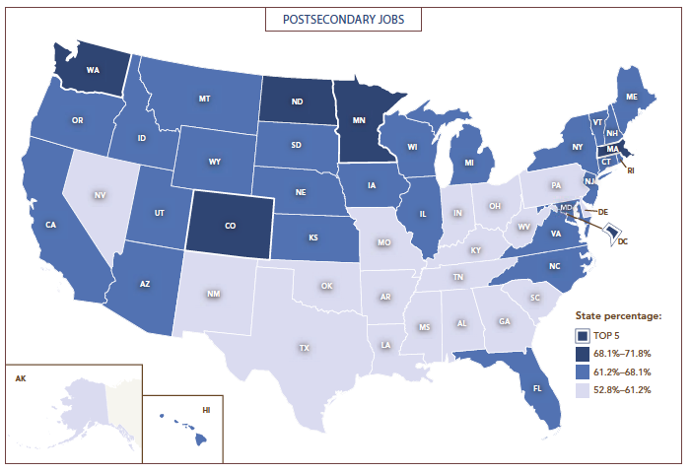
How will you compete?
In 2017, 102 million jobs (about 80%) will require more than a high school diploma.
States around NC have less jobs for college grads. So, those college grads will come HERE for jobs.
You compete with people who come here from many other states with college degrees for jobs.
Raleigh area is one of fastest growing areas in USA because of this.

Slide 4
So start planning NOW!
CFNC Accounts:
Plan for career
Plan for college
Get ready for SAT, ACT
Apply for FREE Nov. 10 - 14
Learn how to get $$$ for college
Senior meetings THIS WEEK.
Senior Night: Oct. 6
SAT Prep Workshop: Oct. 4
Brag Sheets
Transcripts/Email reference

Slide 5
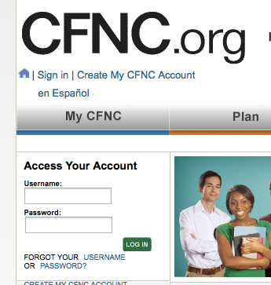
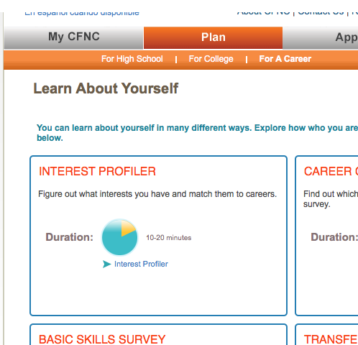
But what do I want to be?
2
3
1
4
If you do not remember your username and password, we will need to help you.

Slide 6
Where do I go for that?
After the profile come results. Which careers did the assessment suggest?
Click on the careers that interest you to find what majors/programs are suggested to enter that career.
Now we need to know what to do next …
What GPA, ACT/SAT scores, class rank do I need to aim for?
What is the cost of this college?

Slide 7
How do I get in there?
1
2
3

Slide 8
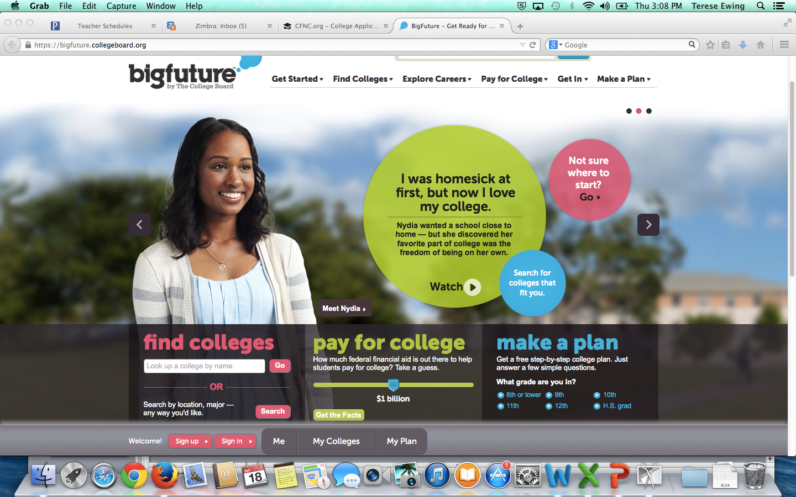
But what if I don’t want to stay in NC?
For out of state colleges, visit https://bigfuture.collegeboard.org

