Slide 1
North Carolina Association of Student Financial Aid Administrators & North Carolina State Education Assistance Authority Presents…
Financial Aid for College
2014-2015

Slide 2
Topics We will Discuss
What is financial aid?
Cost of attendance (COA)
Expected family contribution (EFC)
Financial need
Categories, types, and sources of financial aid
Free Application for Federal Student Aid (FAFSA)

Slide 3
What is Financial Aid?
Financial aid consists of funds provided to
students and families to help pay for
postsecondary (college) educational expenses

Slide 4
Need-based Aid Principles
Family is responsible for costs to the extent of its ability to pay college costs
Aims to provide college access and choice
Aid eligibility is based on a “snapshot” of the family situation at a particular point in time, not a video…..

Slide 5
What is Cost of Attendance (COA)?
Direct costs “Direct Educational Expenses”
Indirect costs “Indirect Educational Expenses”
Direct and indirect costs are established by each institution
COA varies widely from college to college

Slide 6
Direct Educational Expenses
Tuition
Required fees
Room
Board (Meals)
Books and Supplies

Slide 7
Indirect Educational Expenses
Transportation
Does not include the lease/purchase of a vehicle
Miscellaneous personal expenses, including documented costs for a personal computer
Loan fees

Slide 8
What is Expected Family Contribution (EFC)?
Calculated by U.S. Dept. of Education using data from Free Application for Federal Student Aid (FAFSA)
Amount family can reasonably be expected to contribute toward educational expenses for academic year
Has two components:
Parent Contribution & Student Contribution
Stays the same regardless of selected college
Notes:
Parent Contribution- Uses parent income and assets (after protecting some assets and income for basic living expenses). Primary home is a protected asset that is not factored into the calculation.
Student Contribution- Uses student income and assets (after protecting some assets and income up to $6,130)

Slide 9
EFC Determination Formula
Parents’ contribution
+ Student’s contribution
= Expected Family Contribution
Resource to review: FAFSA Forecaster fafsa.gov

Slide 10
Basic Formula for Financial Aid Need
Cost of Attendance (COA) (varies)
Expected Family Contribution (EFC)
Eligibility for Need-Based Funds
-
=
Notes:
The cost of attendance varies from one institution to another

Slide 11
Types of Financial Aid
Grants
Scholarships
Loans
Employment

Slide 12
Categories of Financial Aid
Non-need based (Merit)
academics
talent
athletic
others
Need-based
financial considerations

Slide 13
Gift Aid: Grants
Money that does not have to be paid back
Usually awarded on the basis of financial need

Slide 14
Gift Aid: Scholarships
Money that does not have to be paid back
Awarded on the basis of merit, skill, or unique characteristic

Slide 15
Self-Help Aid: Loans
Money students and parents borrow to help pay college expenses
Repayment usually begins after education is finished
View loans as an investment in the future
Only borrow what is needed for educational expenses

Slide 16
Self-Help Aid: Employment (Work-Study)
Allows student to earn money to help pay educational costs
A paycheck; or
Nonmonetary compensation, such as room and board

Slide 17
Sources of Financial Aid
Federal Government
State Programs
Institutional funds
Outside agencies

Slide 18
Federal Student Aid Programs
Federal Pell Grant
Federal Supplemental Educational Opportunity Grant (FSEOG)
Federal Work-Study (FWS)
Federal Direct Loans (Subsidized, Unsubsidized & Plus)
Federal Perkins Loan
Teacher Education Assistance for College and Higher Education (TEACH) Grant
Iraq and Afghanistan Service Grant (IASG)
Visit studentaid.gov for additional information

Slide 19
Details about Federal Loans
Interest rate is set each year for the life of that loan.
Interest rate for loans made in 2013-14 academic year:
Federal Direct Subsidized and Unsubsidized Stafford Loans
3.86% (undergraduate )
5.41% (graduate)
Federal Direct PLUS Loan – 6.41%
Legal parents of dependent students
Graduate/professional students
Federal Perkins Loan—5%
Note: Rates for 2014-15 will be released in July 2014
Notes:
Interest rates are fixed

Slide 20
North Carolina Aid Programs (partial listing)
NC Community College Grant
UNC Need-Based Grant
NC Education Lottery Scholarship
NC Need-Based Scholarship
Forgivable Education Loans for Service (NC FELS)
Visit CFNC.org for additional information

Slide 21
NC Reach Program
Funding for former foster youth who:
Age(d) out of NC public foster care at age 18
Were adopted from foster care after age 12
Eligibility requirements
Age 18 – 25 and meet above criteria
NC Community College or one of UNC System’s 16 campuses
Enroll on half-time basis or more
Seek undergraduate degree/certificate /diploma
Program is designed to be combined with other aid and cover the full cost of attendance
Visit ncreach.org for additional information and to apply

Slide 22
Institutional and Outside Aid
Institutional Aid
Grants & Scholarships
Loan Programs
Student Employment
Outside Agencies*
Local organizations
Churches
Civic Groups
Parents’ employers
Veterans Administration
*Deadlines and application procedures vary
widely
*Begin researching early

Slide 23
Alternatives
Private alternative loans for students or parents
Last resort--Always apply for federal loans first!
College payment plans
Outside scholarships
Notes:
Restate the importance of seeking outside scholarship opportunities and beginning the process early.

Slide 24
Free Application for Federal Student Aid (FAFSA)
Collects demographic and financial information about the student and family
Must be completed for each year that aid is desired
May be filed electronically or using paper form
-- Available in English or Spanish
Used to calculate the Expected Family Contribution (EFC)
Colleges use EFC to award need-based financial aid
Contact colleges of interest to determine FAFSA filing deadlines
March 1 is the deadline for the 16 UNC campuses

Slide 25
FAFSA (continued)
FAFSA can be filed beginning January 1, 2014 for 2014-2015
-- Electronically at fafsa.gov
-- Can obtain paper form: 800-4-FED-AID (1-800-433-3243)
Results generally available online in 48 hours to you and the institutions you list on the FAFSA
Note:
Student and parent whose information is reported on the FAFSA must obtain a
Personal Identification Number (PIN) to sign electronic application.
Notes:
99.99% of forms are filed online!
Of the 18m FAFSAs completed last year, approximately 40,000 were paper. It is highly recommended to complete FAFSA electronically due to built in edit checks and assistance guides that increase accuracy, skip logic that allows skipping of unnecessary questions and provides option of using IRS Data Retrieval Tool.
FAFSA on the Web Worksheet: Available at www.fafsa.gov to help you gather needed data for actual FAFSA form. Questions follow order of FAFSA on the Web

Slide 26
What is a Personal Identification Number (PIN)?
A PIN is issued to an individual and is a “signature” for Federal Student Aid purposes
Parent’s PIN may be used for multiple children
Each student must have own PIN
PIN will expire if not used for 18 consecutive months
PIN can be obtained at pin.ed.gov
Notes:
Using PIN to act as electronic signature decreases processing time in comparison to using paper signature page that has to be mailed to the U.S. Dept. of Education’s processing center

Slide 27
IRS Data Retrieval Tool (DRT)
DRT is available within the FAFSA on the Web (FOTW)
Available early February 2014 for 2014-2015 FOTW
Within several days for electronic tax filers
Within several weeks for paper tax filers
Available to those who have filed 2013 federal taxes and
now are:
Completing the FAFSA
Correcting their FAFSA (updating with IRS data)
DRT not available when:
Married filing separately tax filing status is used
Head of Household tax filing status is used
Marital status changed after 12/31/13
Amended or foreign tax returns filed

Slide 28
DRT (continued)
To use the Tool, must have:
A valid Social Security Number
Filed a 2013 federal tax return
The exact street address and filing status used on the tax return
Filtering question on FAFSA helps determine if you can use DRT
IRS Data Retrieval Process meets verification requirements
Secure and FAST option
Students (and parents) not using the “Tool” and selected for verification:
In most cases, must submit an IRS Tax Return Transcript rather than a Tax Return

Slide 29
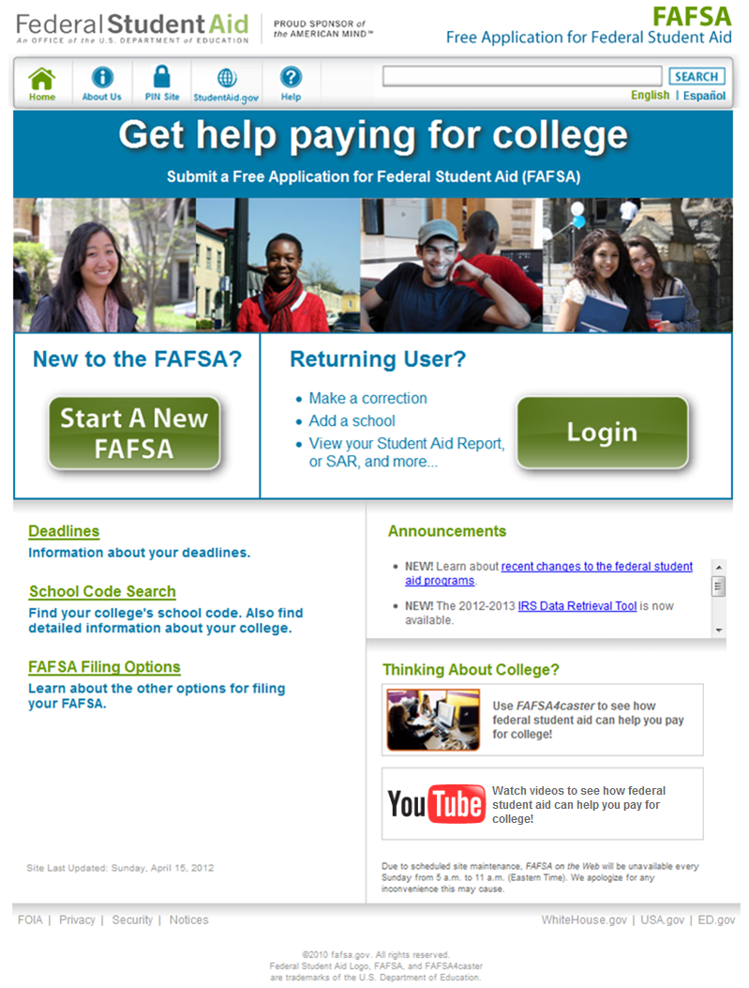
FAFSA on the Web’s Homepage

Slide 30
Before Beginning a FAFSA
Gather the documents you need
Print and complete a FAFSA on the Web Worksheet
Apply for a PIN now!

Slide 31
FAFSA on the Web Worksheet
Complete the Worksheet to help you complete the FAFSA on the Web
Questions on the Worksheet are ordered the same as they are online
Questions on the paper FAFSA are ordered differently than they are online
The FAFSA Worksheet is available as a PDF at fafsa.gov

Slide 32
Message for Applicants Who Indicate They “Will File” Their Taxes

Slide 33
IRS Data Retrieval Tool Filtering Question

Slide 34
Signing the FAFSA
After completing the FAFSA, student and parent (if dependent) must sign by:
Entering PIN
Both student and one parent should each have PINs
OR
Print signature page, sign and mail to address provided within 7 days

Slide 35
Sign the Application and Submit by clicking “Submit My FAFSA Now”
The Sign & Submit page includes the signature process for the student

Slide 36
FAFSA Confirmation Page
Next steps
EFC estimate
Pell Grant & Direct Loan estimates

Slide 37
What happens after I file the FAFSA?
Complete verification if required
Respond to any questions from the campus aid office
Receive financial aid notification
Reply to offers of aid (and admission)
Complete all steps necessary to secure offered aid you intend to accept
Notify campus of outside scholarships
Notes:
Respond promptly to colleges if additional information requested
Tax return transcripts or other information
College will notify via email, Web or mail of aid eligibility
Student should follow colleges’ instructions to accept or decline aid offered.

Slide 38
Miscellaneous Information
You Should Know

Slide 39
Dependency
Students are considered independent for financial aid purposes if:
24 years old or older
Orphan, foster child/ward of the State
Have children for whom they provide more than 50% support
Have a legal guardian
Married
Veteran or on active duty
Graduate students
Legally emancipated
Homeless or at risk of homelessness
Students not meeting one of the above must include parental information for full aid consideration.

Slide 40
Who Are Considered Parents
on the FAFSA?
Biological or adoptive parents (regardless of gender):
Parents married and living with each other
Parents unmarried and living with each other
Parent widowed or single
Parents divorced or separated—answer questions for parent
with whom student lived more during past 12 months
If equal time between each parent, answer for the parent who
provided more financial support during the past 12 months
If custodial parent has remarried, answer about that parent and the
person whom parent married (stepparent)
Notes:
“Parent” refers to a biological or adoptive parent
An adoptive parent is treated just like a biological parent

Slide 41
Who Are Not Considered
Parents on the FAFSA?
Foster parents
Legal guardians who have not adopted the student
Relatives, such as grandparents, who have not adopted the
student
Stepparents who have not adopted the student and the natural parent in the household is deceased. Must use remaining biological/adoptive parent, if any.
Notes:
NOT considered parents: Grandparents, foster parents, legal guardians, older siblings, and uncles or aunts unless they have legally adopted student
A stepparent who did not adopt the student cannot be the sole parent for determining dependency status. If the other parent dies, the student is still a dependent of the remaining biological parent, not the stepparent. If no biological parent remains, the student is independent

Slide 42
FAFSA Verification
Additional documentation may be required… for VERIFICATION of application:
Adjusted Gross Income (AGI)
U.S. income tax paid
Additional Financial Information
Child support paid
Education credits
Supplemental Nutrition Assistance
Untaxed Income – only if reportable on the FAFSA
Untaxed IRA and pension distributions
IRA deductions
Tax exempt interest
Notes:
Note: Being selected for verification does not mean that you have done something wrong. The U.S. Dept. of Education randomly selects submitted FAFSA to undergo this review process. Schools are also authorized to select FAFSA records for verification as they deem necessary.

Slide 43
Dependent Student Special Circumstance
If parents refuse to complete FAFSA:
Contact financial aid administrator
Student may be allowed to submit the FAFSA without parental information
Student will only be eligible for an UNSUBSIDIZED Loan.
Parent section is not optional if the student
wants total aid eligibility!

Slide 44
Special Circumstances
Family situations that cannot be documented on FAFSA, such as:
Change in employment status
Death in the family
Change in parents’ marital status
Medical expenses not covered by insurance
Student cannot obtain parent information
Make the financial aid office at your selected college aware of any special circumstances. Be prepared to provide documentation related to the situation, including the financial impact of the change.

Slide 45
Potential Institutional Adjustments to EFC for Institutional Funds
Minimum contribution from students to their educational costs (summer earnings)
Use home equity in determination of net assets
Make adjustments for medical/dental expenses
Make adjustments in the losses/depreciation claimed for business/farm operations

Slide 46
Applying for Financial Aid
Other forms ….
Institutional application
College Scholarship Service PROFILE
State applications
Outside scholarship applications

Slide 47
Potential Tax Filer Benefits
American Opportunity Tax Credit
2013 Tax Year details
Available for the first four years of college to assist with tuition, fees and required books
Up to $2,500 tax credit –reduces amount of taxes owed; up to 40% refunded when no income tax due
100% of first $2,000 expenses and 25% of the next $2,000
Examples:
Tuition of $8,000 paid - May claim $2500 on the tax return completed
Tuition of $3,000--May claim $2,250 (all of the first $2000, and 25% of the remaining tuition…which is $250)

Slide 48
Potential Tax Filer Benefits (continued)
Lifetime Learning Credit
2013 Tax Year details
Available for all years
Can claim for remaining undergraduate years and graduate study as well as professional development classes.
Can claim credit for 20% of tuition & fees, up to maximum of $2,000.

Slide 49
Potential Tax Filer Benefits (continued)
IRS Deductions and Credits
2013 Tax Year details
Families with adjusted gross incomes up to $80,000 (single filers) & $160,000 (joint filers) can claim tax credits.
Certain taxpayers will qualify to take a tax deduction for tuition and fees of up to $4,000 (even if they don’t itemize).
Cannot claim American Opportunity or Lifetime Learning Credit in the same year as deduction for same student.
There are restrictions on who can claim IRS tax credits and deductions ….. Consult with your tax advisor or do your research!
Visit irs.gov for additional information

Slide 50
BEWARE! Offers to help get financial aid are everywhere:
In the mail
Over the Internet
In newspapers
In magazines
Over the phone

Slide 51
“Help” offers that should be avoided
Organizations that offer to locate more aid and then charge you a fee
Anyone who charges you a fee:
for information about financial aid
to complete the FAFSA
to apply/receive a scholarship
Organizations that guarantee you will get a scholarship or aid

Slide 52
For free information about financial aid
Contact College Foundation of North Carolina at CFNC.org or toll free at
866-866-CFNC
Service of the State of North Carolina
Contact a college financial aid administrator
Ask your high school counselor
Visit the local library
Apply for financial aid at fafsa.gov (notice it is not FAFSA.com)

Slide 53
Additional information
College Foundation of North Carolina
CFNC.org
Federal Department of Education
studentaid.gov
Student Financial Aid for North Carolinians
CFNC.org/fabook
The SmartStudent Guide to Financial Aid
finaid.org

Slide 54
Summary
Aid available from federal and state governments, colleges and outside agencies
Don’t wait until you are accepted to your colleges of choice to file the FAFSA
Meet earliest FAFSA deadline of colleges you are interested in attending
Get your taxes done before March, if possible!
Estimate if necessary to meet early deadlines
Complete all questions as accurately as possible
Keep a photocopy of all documents for your records
Student and parent should each have a PIN (pin.ed.gov)
Complete, sign and submit application (fafsa.gov)

Slide 55
Need Help? FAFSA Day 2014
Saturday, February 22, 2014
Any time between 9 a.m. and noon in most locations
Get FREE help completing your FAFSA from college financial aid officers.
Visit CFNC.org/fafsaday or call toll-free at 866-866-CFNC(2362) to:
Learn more
Find closest location
Register
Sponsored by:
College Foundation of North Carolina
North Carolina Association of Student Financial Aid Administrators, and
State Employees Credit Union

Slide 56
Questions?

