Slide 1
You are cordially invited
To a successful career!
Created by Terese Ewing

Slide 2
What is a successful career?
Careers that require higher education:
pay more
have more security
give better benefits (like health insurance, education reimbursement, retirement plans, etc.)
But do I really need school after high school?

Slide 3
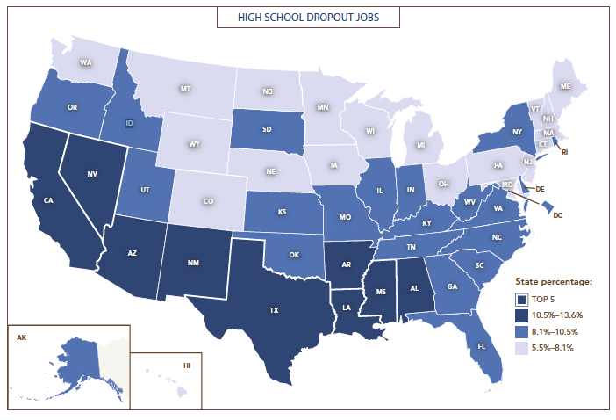
Where will dropouts work?
In 2017, 102 million jobs (about 80%) will require more than a high school diploma.

Slide 4
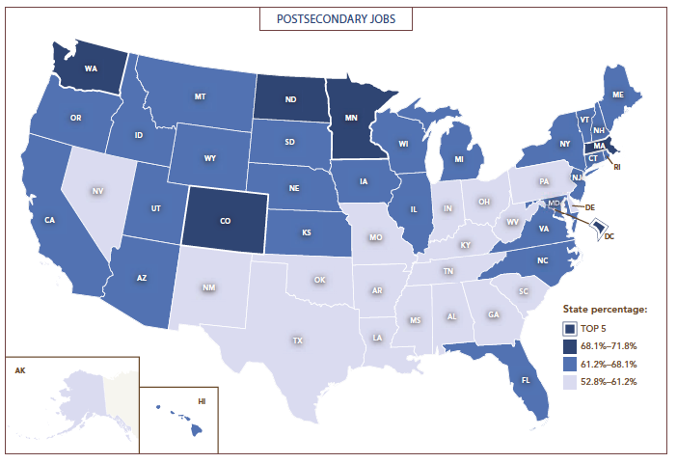
Where will dropouts work?
States around NC have less jobs for college grads
Those folks come to NC for jobs
You compete with people who come here from many other states with college degrees for jobs.
Raleigh area is one of fastest growing areas in USA because of this.
Who will get the job?

Slide 5
So start planning NOW!
CFNC Accounts:
Plan for career
Plan for college
Find out more about careers
Find out about all NC college
Get ready for SAT, ACT
Learn how to get $$$ for college

Slide 6
www.cfnc.org

Slide 7
Pick high school student

Slide 8
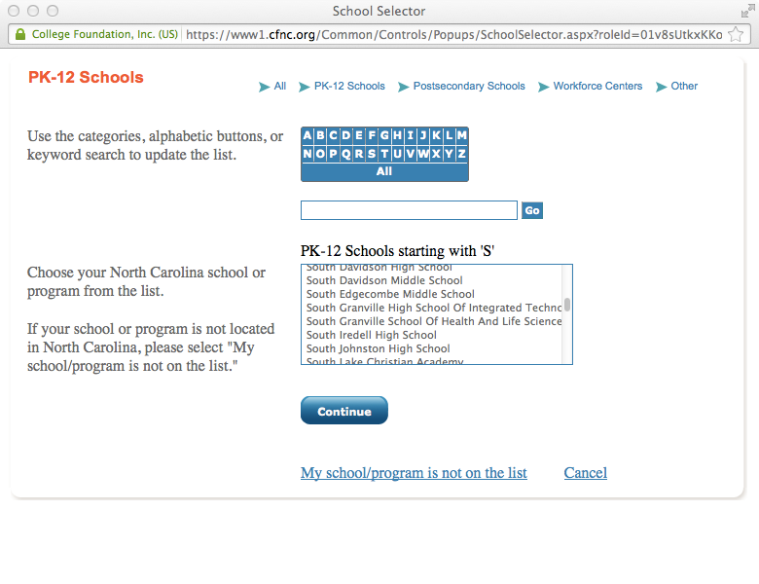
Click “S” in blue box. Pick the SGHS that you are currently in

Slide 9
Write/type then save username, password somewhere!
Use same user name and password you use to log into computer.

Slide 10
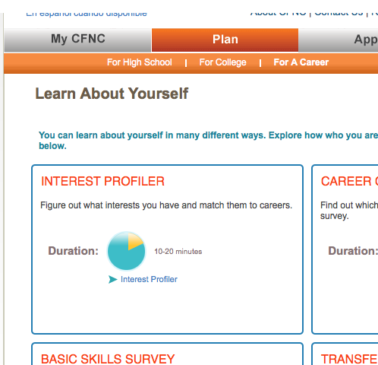
Do interest profiler
1
2
3

Slide 11
Where do I go from here?
After the profile come results. Which careers did the assessment suggest?
Click on the careers that interest you to find what majors/programs are suggested to enter that career.
Go to PLAN then FOR COLLEGE
Click EXPLORE PROGRAMS & MAJORS.
Type in suggested major. Look at NC colleges with programs.
What GPA, ACT/SAT scores, class rank do I need to aim for?
What is the cost of this college?
For out of state colleges, visit https://bigfuture.collegeboard.org

